Slide 1
Valhalla map matching
Xun Liu 11-20-2018

Slide 2
Agenda
What is MapMatching
How MapMatching works
Issues

Slide 3
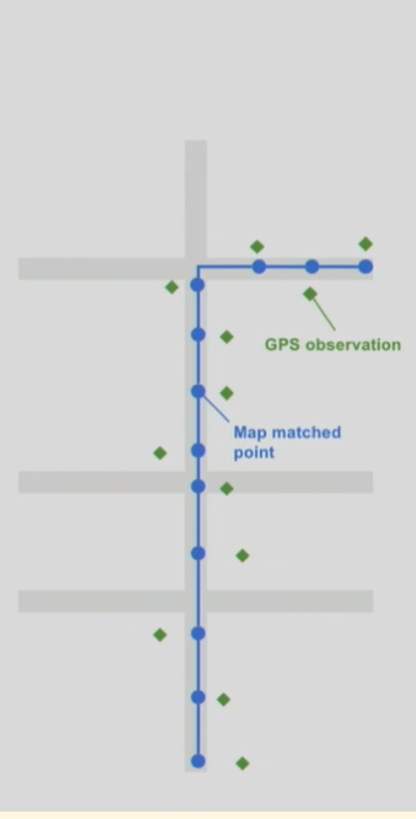
What is map Matching

Slide 4
WHY need Map matching
Location
Where cars are right now
Routes
Where has the car travelled?
ETA & Traffic
How long has it taken to travel along route
Parking
What’s route-able start and end point for cars

Slide 5
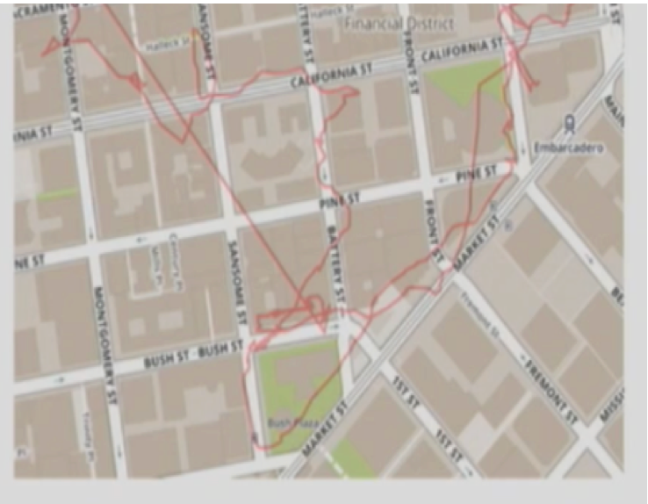
challenge
Poor gps accuracy
Missing prob data
Complex road geometry
Incorrect mapdata

Slide 6
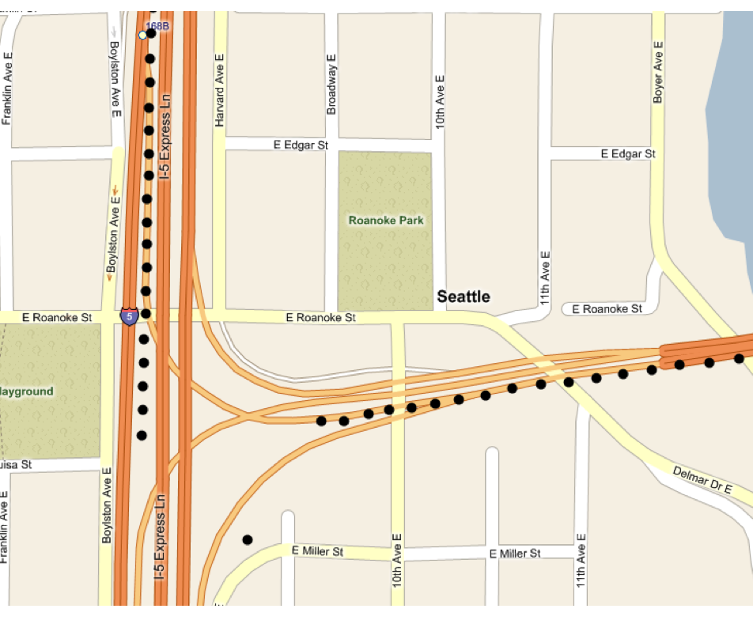
challenge
Poor gps accuracy
Missing prob data
Complex road geometry
Incorrect mapdata

Slide 7
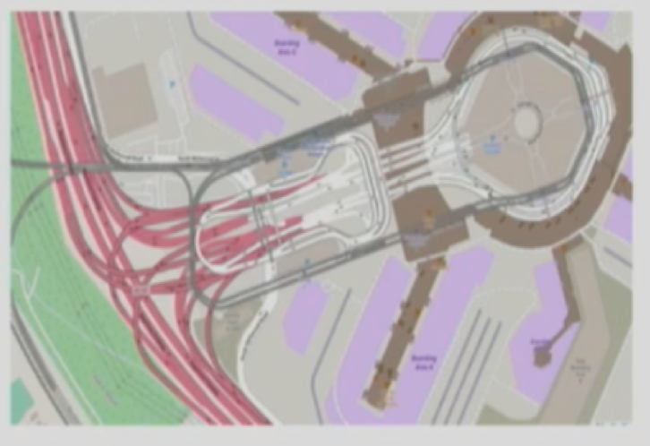
challenge
Poor gps accuracy
Missing prob data
Complex road geometry
Incorrect mapdata

Slide 8
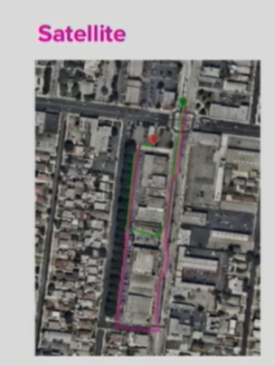
challenge
Poor gps accuracy
Missing prob data
Complex road geometry
Incomplete mapdata

Slide 9
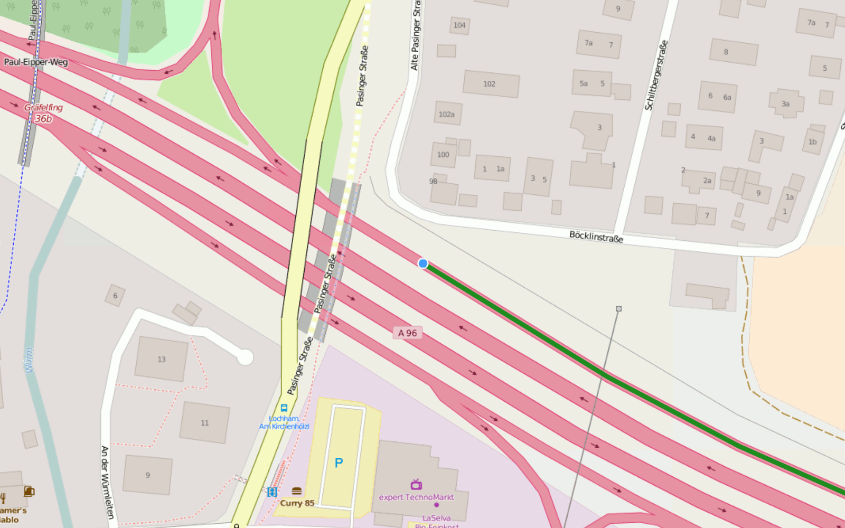
How valhalla works (javascript tool)

Slide 10
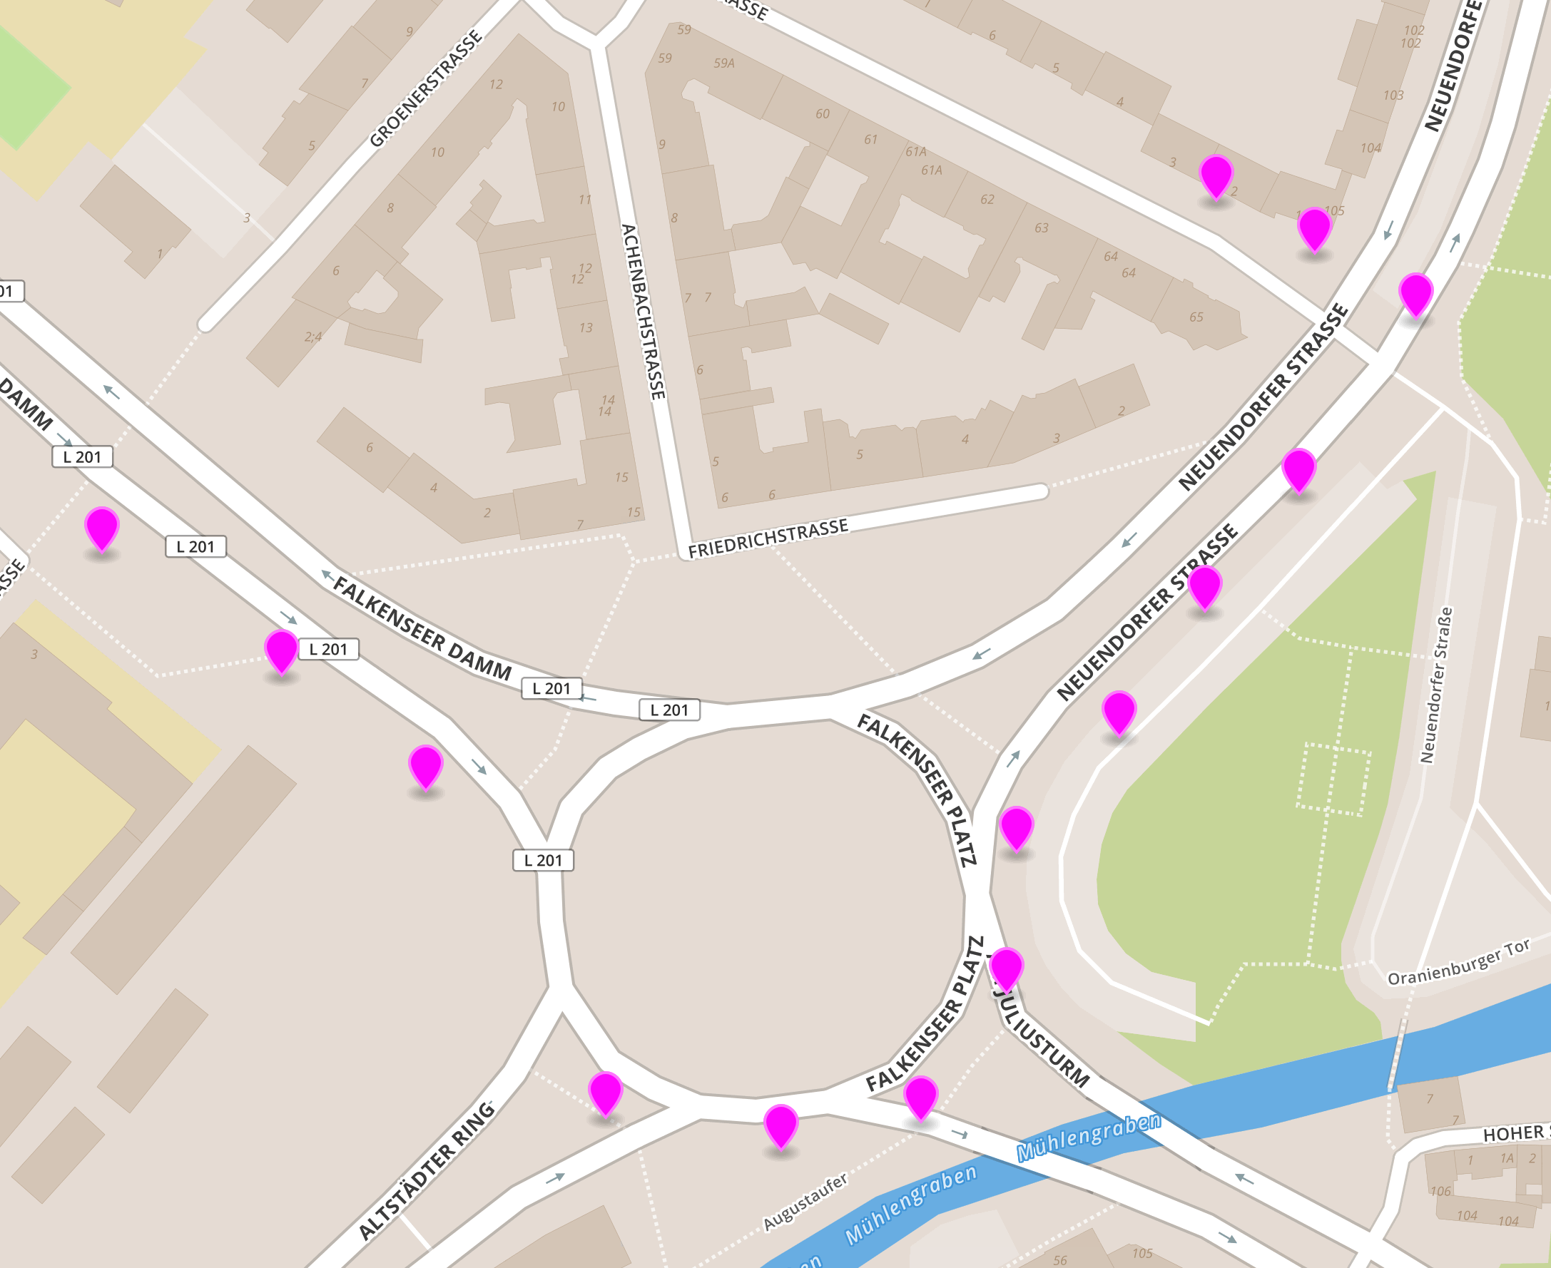
How map matching works

Slide 11
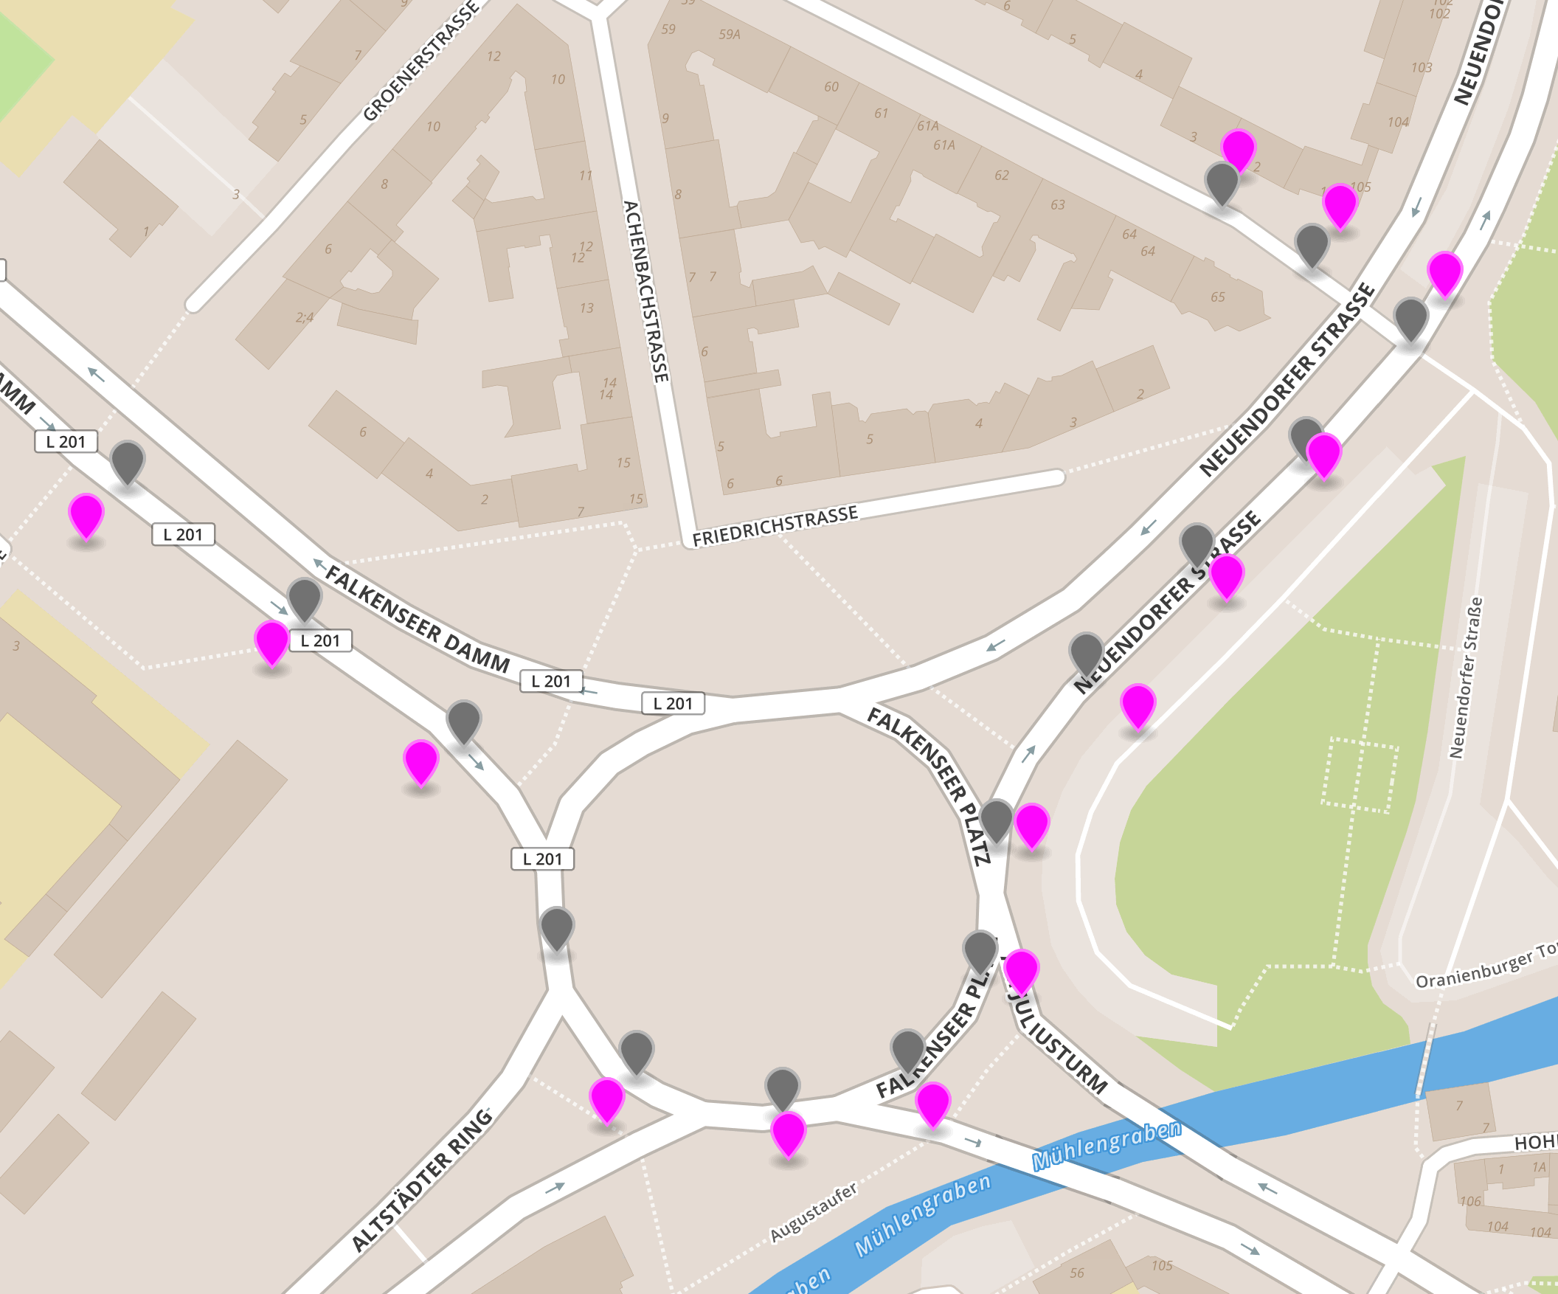
Observations
Map GPS points to nearest road
Reasonable road sequence between points
Incorrect result lead by GPS junk

Slide 12
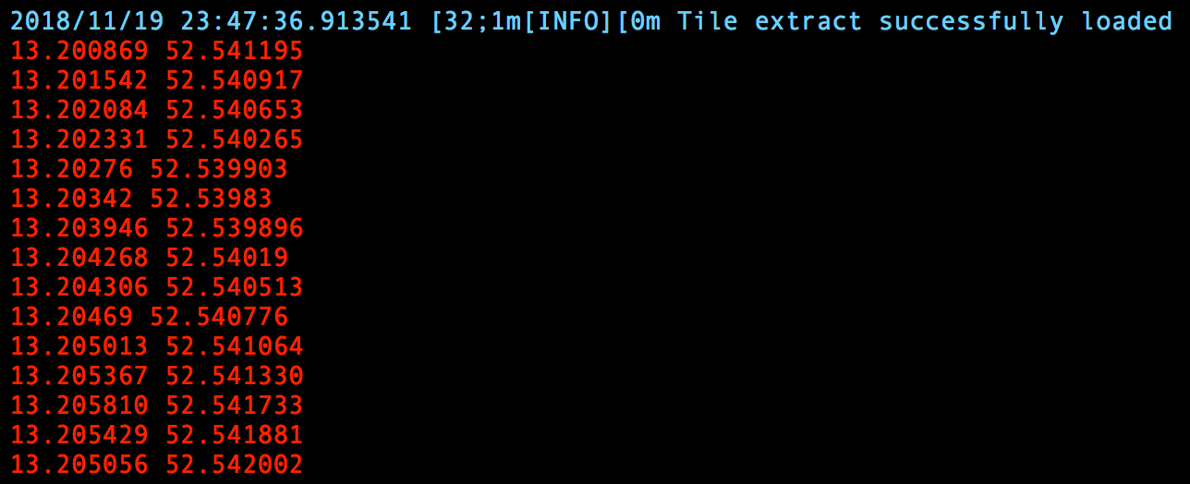
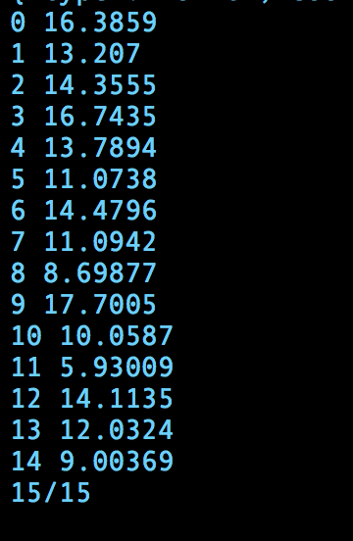
Batch Processing

Slide 13
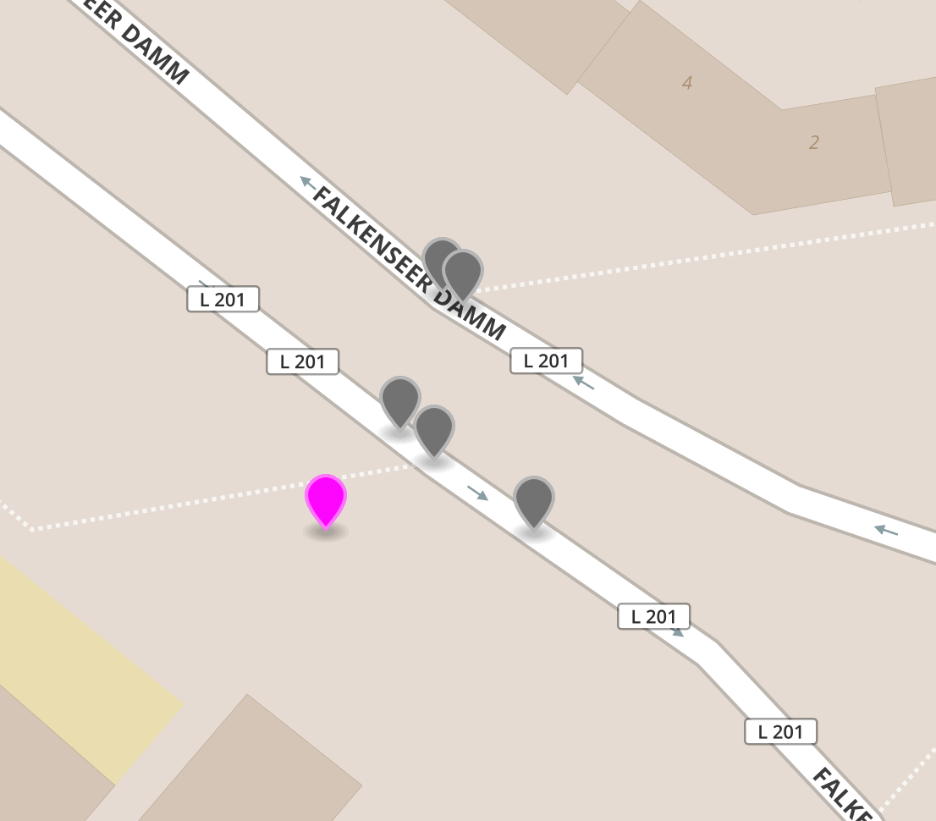
How to match single point

Slide 14
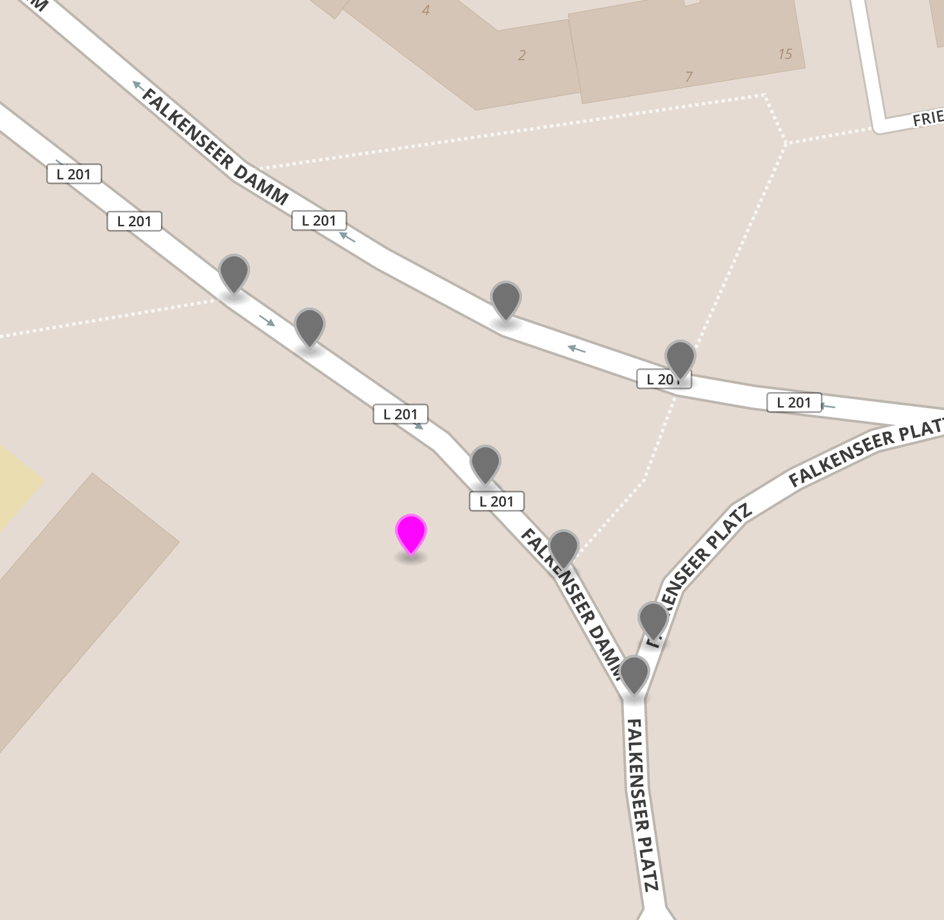
How to match single point

Slide 15
Based on single point
Close segment has higher possibility
Segment which has similar attributes with gps has higher possibility

Slide 16
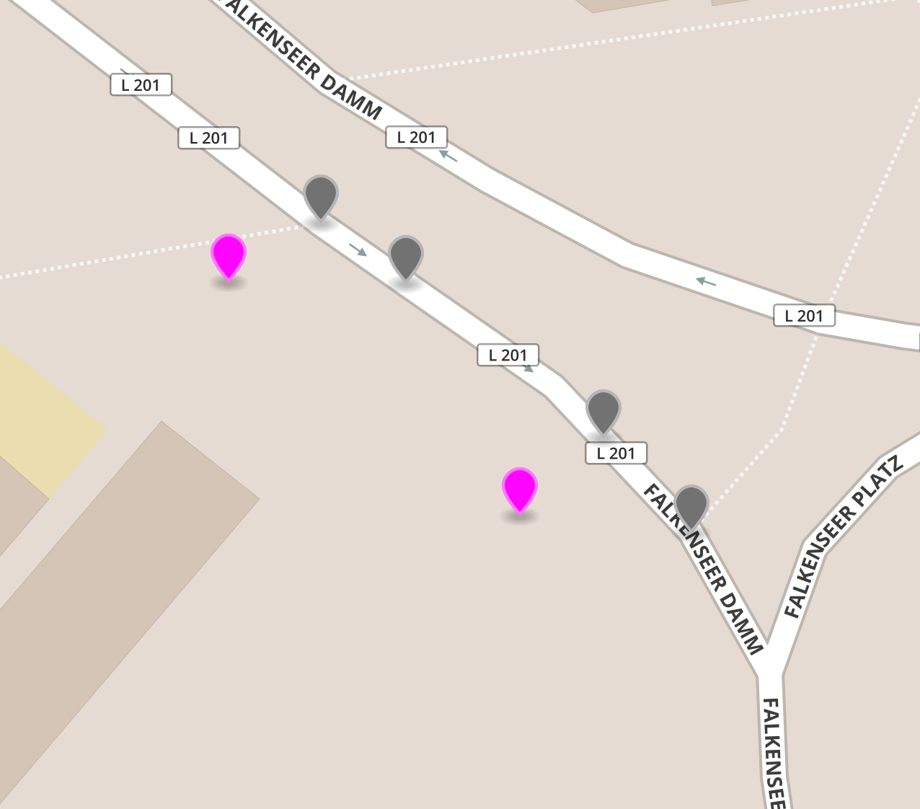
How to match two points

Slide 17
Based on multiple points
Segments pair which are in reverse direction would has lower possibility
Segments pair which are similar as gps pair has higher possibility
Probability should be accumulated

Slide 18
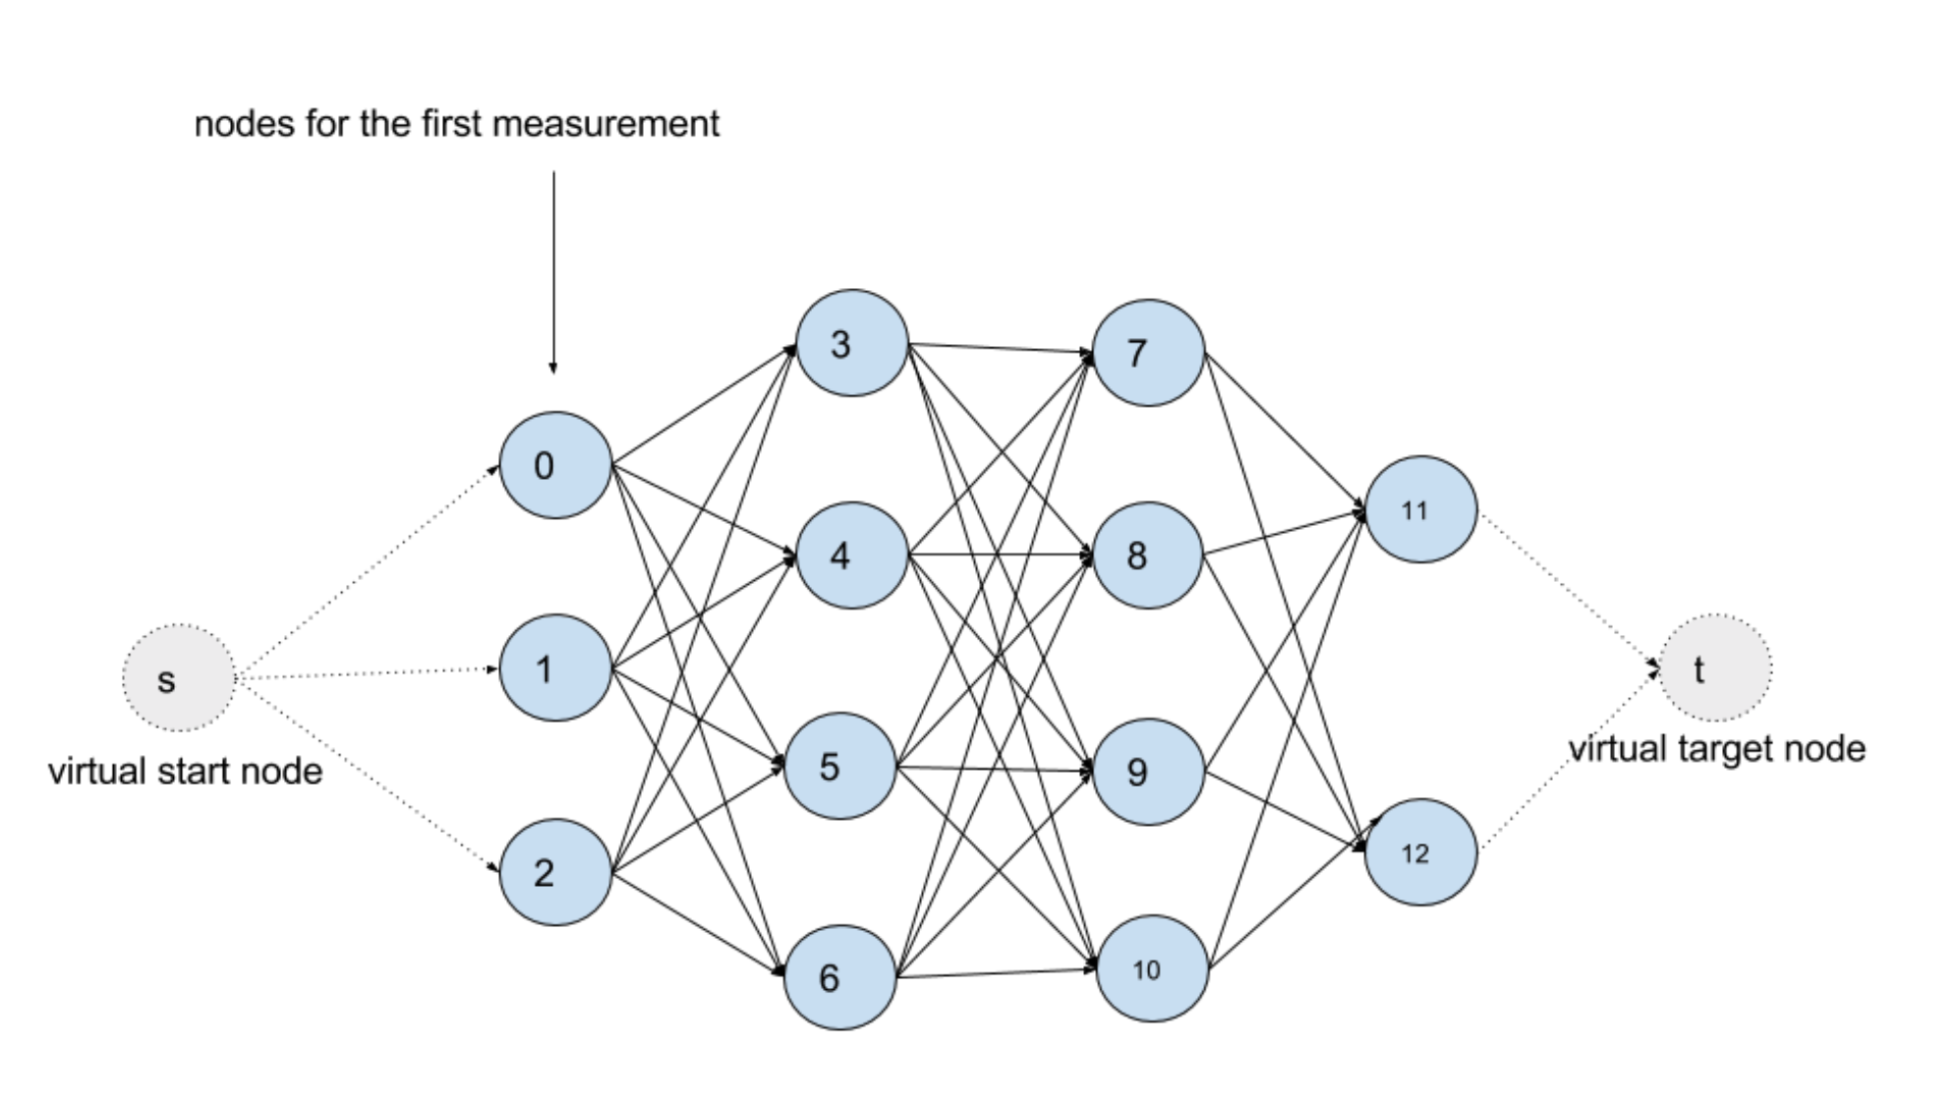
A different way to Think
Treat map matching problem as finding most probable segment list for gps trace
Let’s say for each candidates we convert which as vertex, and add edges between nearby candidates, then assign proper cost for each segments, finally we would get a graph, and find most probable segment list would become find shortest path in the graph

Slide 19
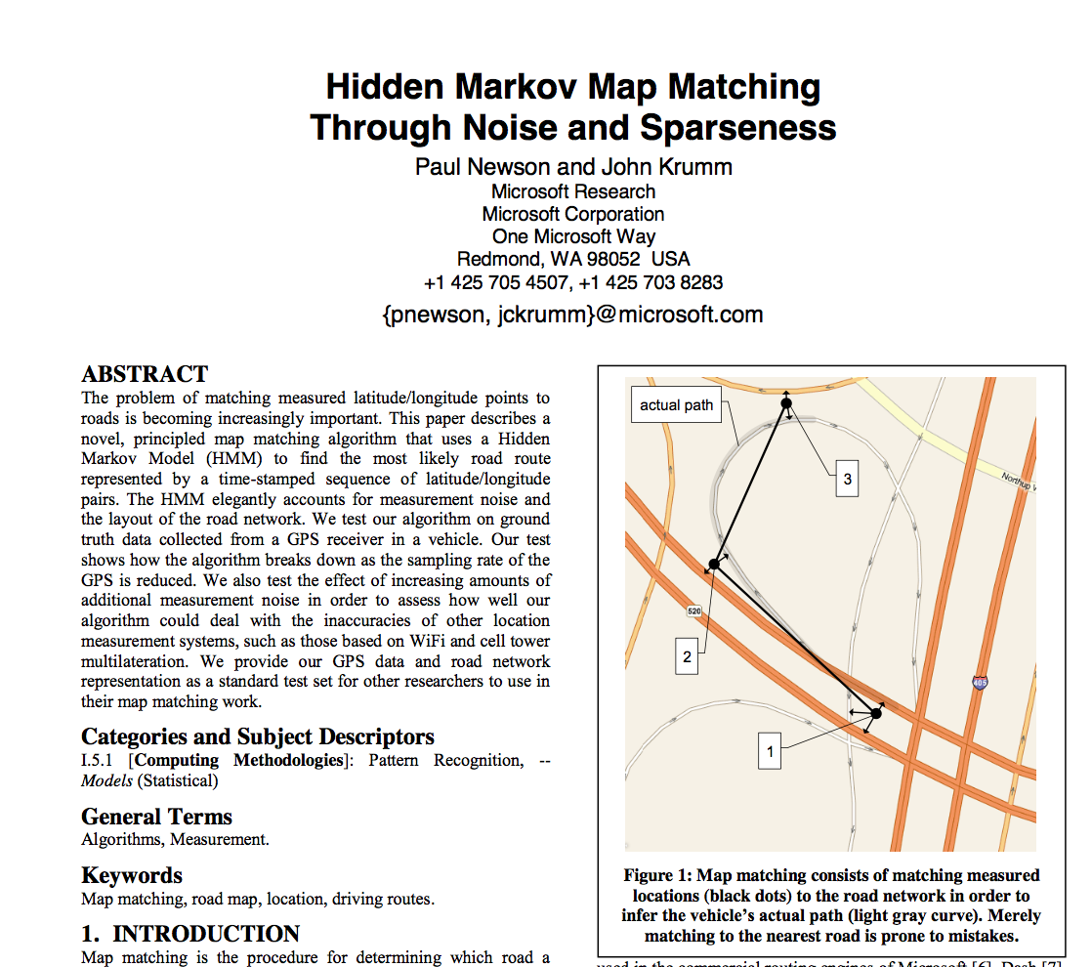
HMM Map Matching through noise and sprseness
Valhalla
OSRM
GraphHooper
Telenav
UBER
LYFT

Slide 20
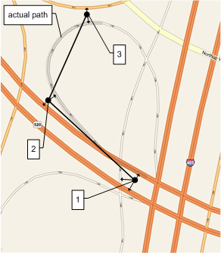
Three Insights
Correct matches tend to be nearby
Successive correct matches tend to be linked by simple routes
Some points are junk, and the best thing to do is ignore them

Slide 21
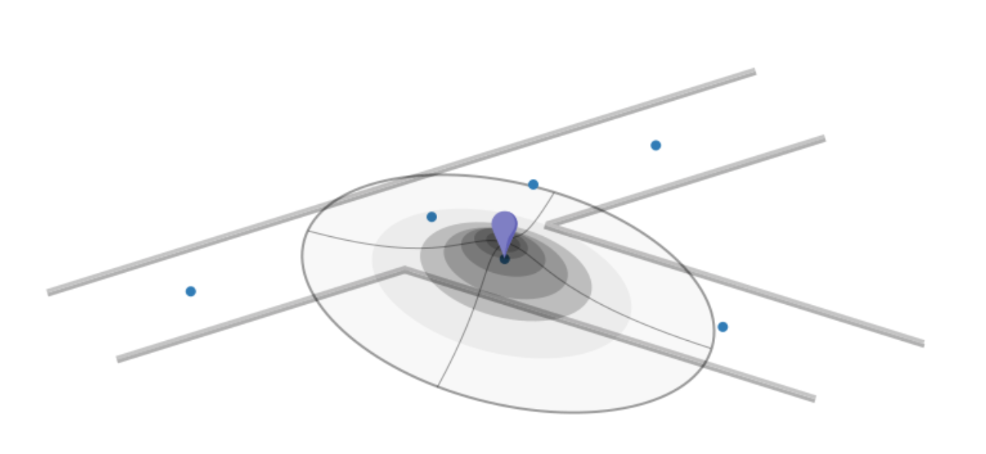
Emission probabilities
Gaussian distribution

Slide 22
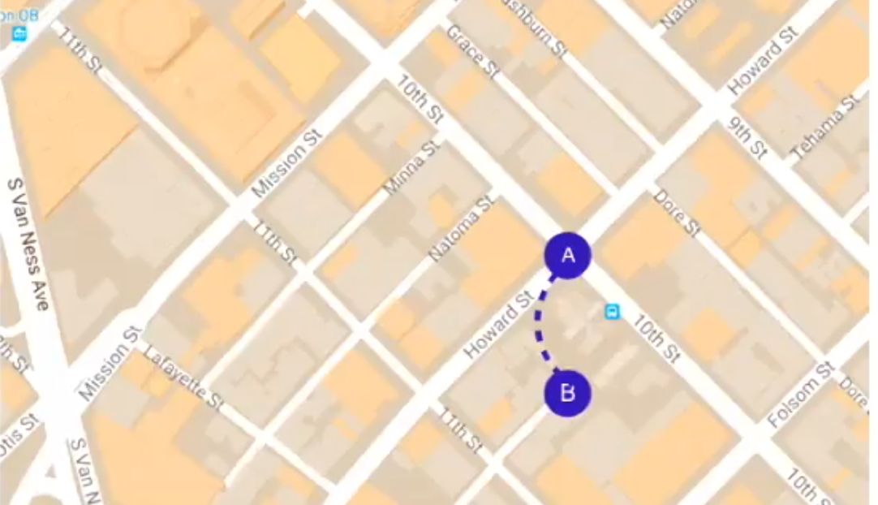

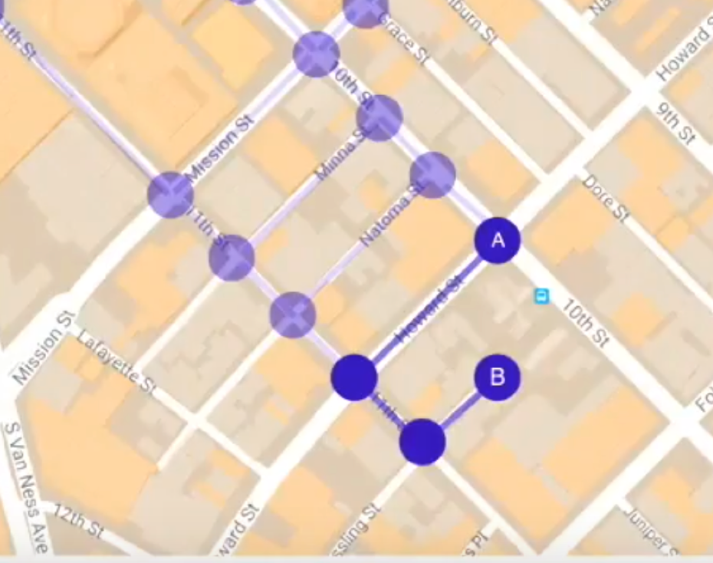
Great cycle distance vs Shortest path distance

Slide 23
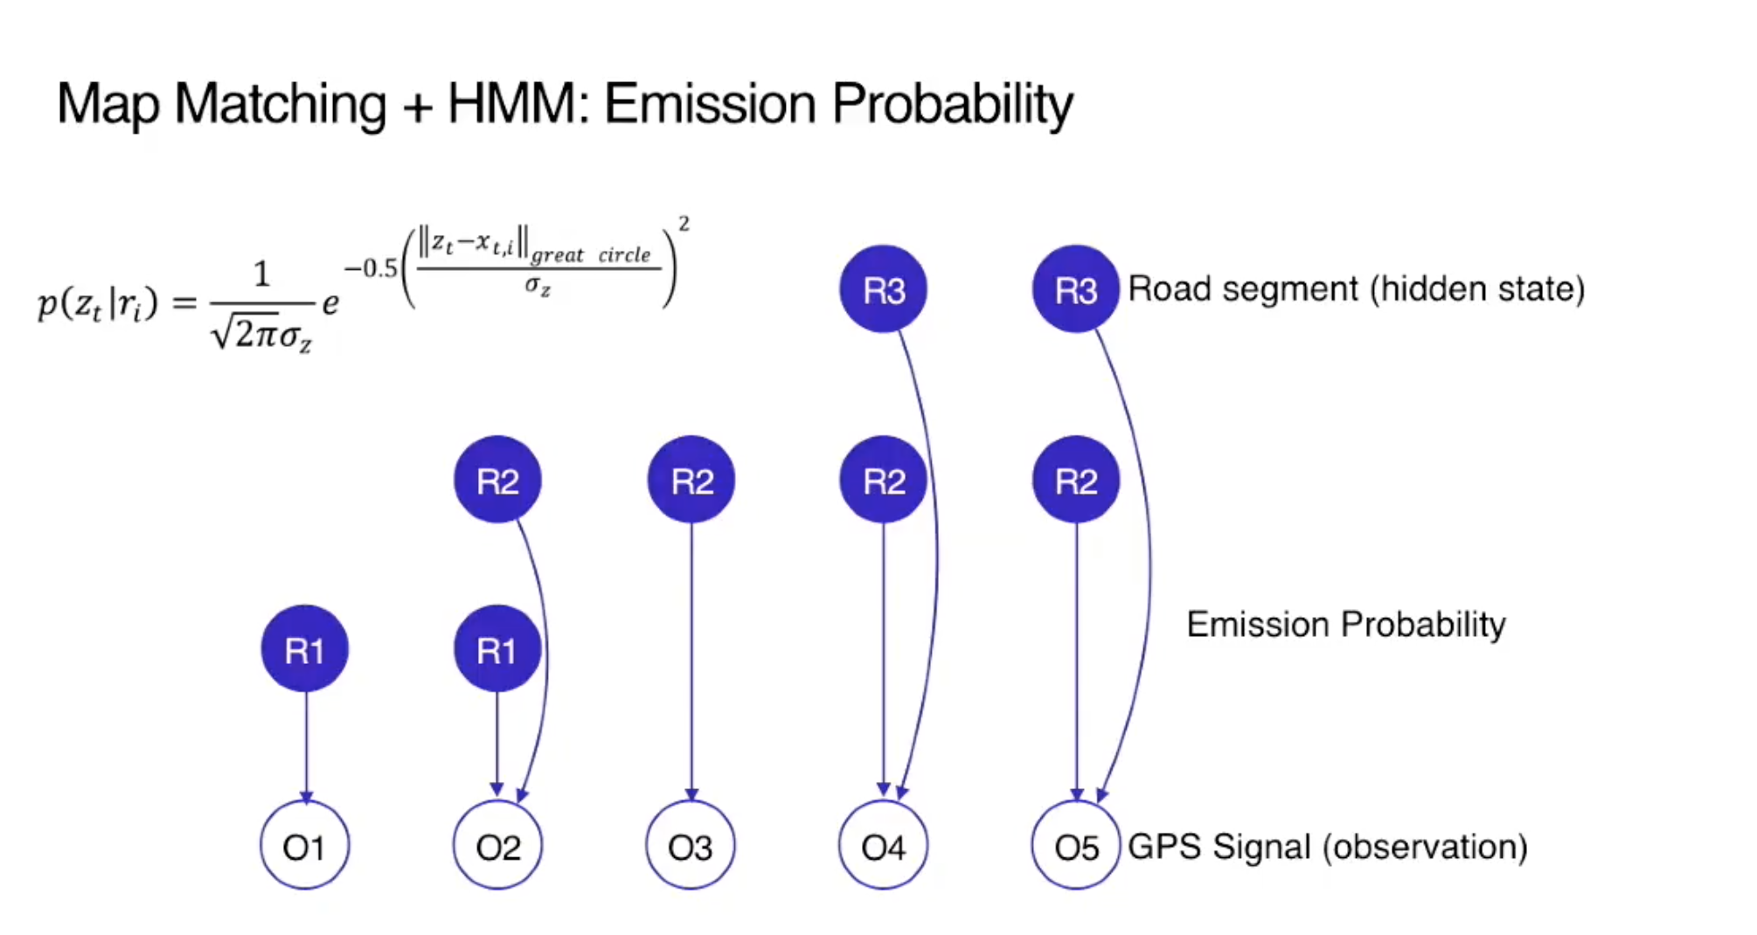

Slide 24
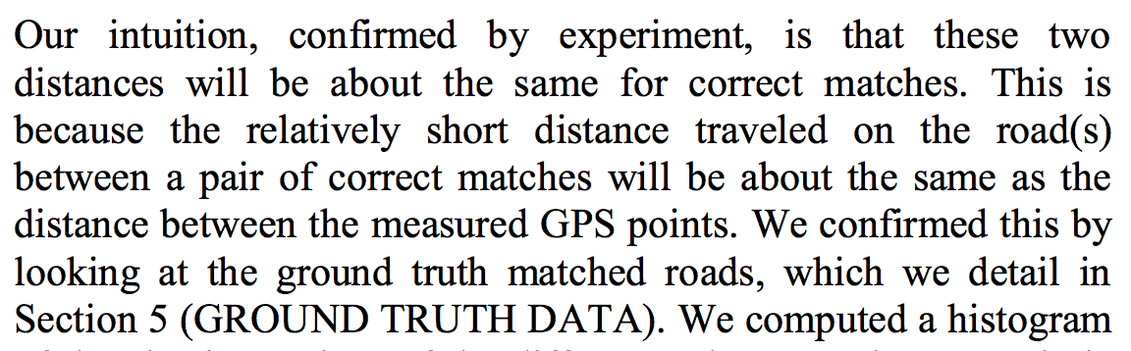
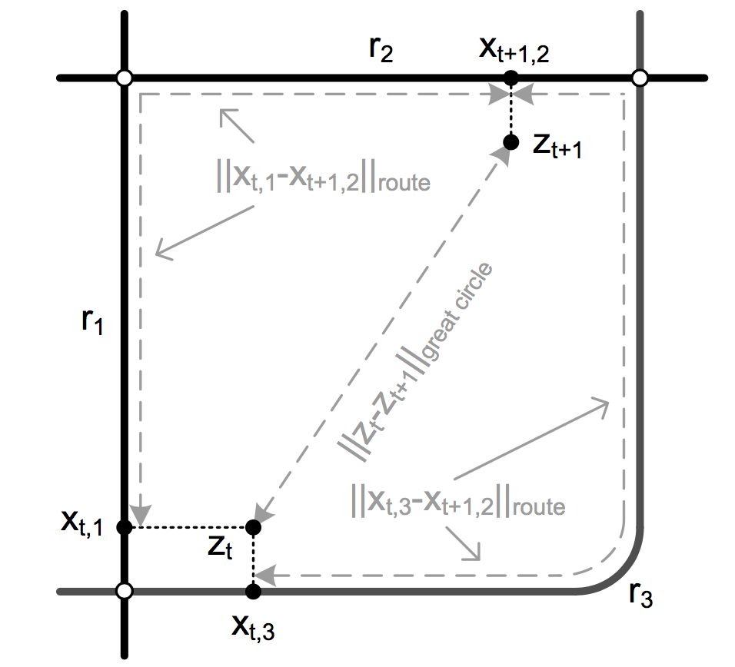
Transition probabilities

Slide 25
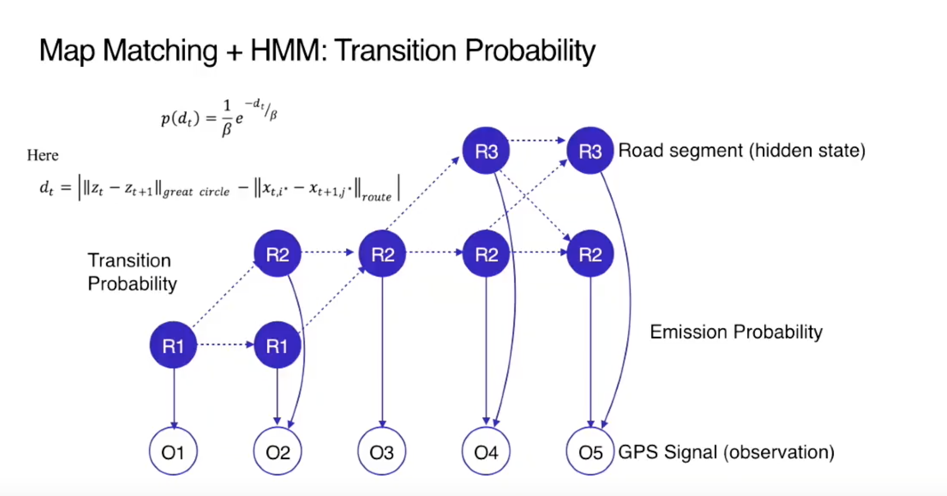

Slide 26
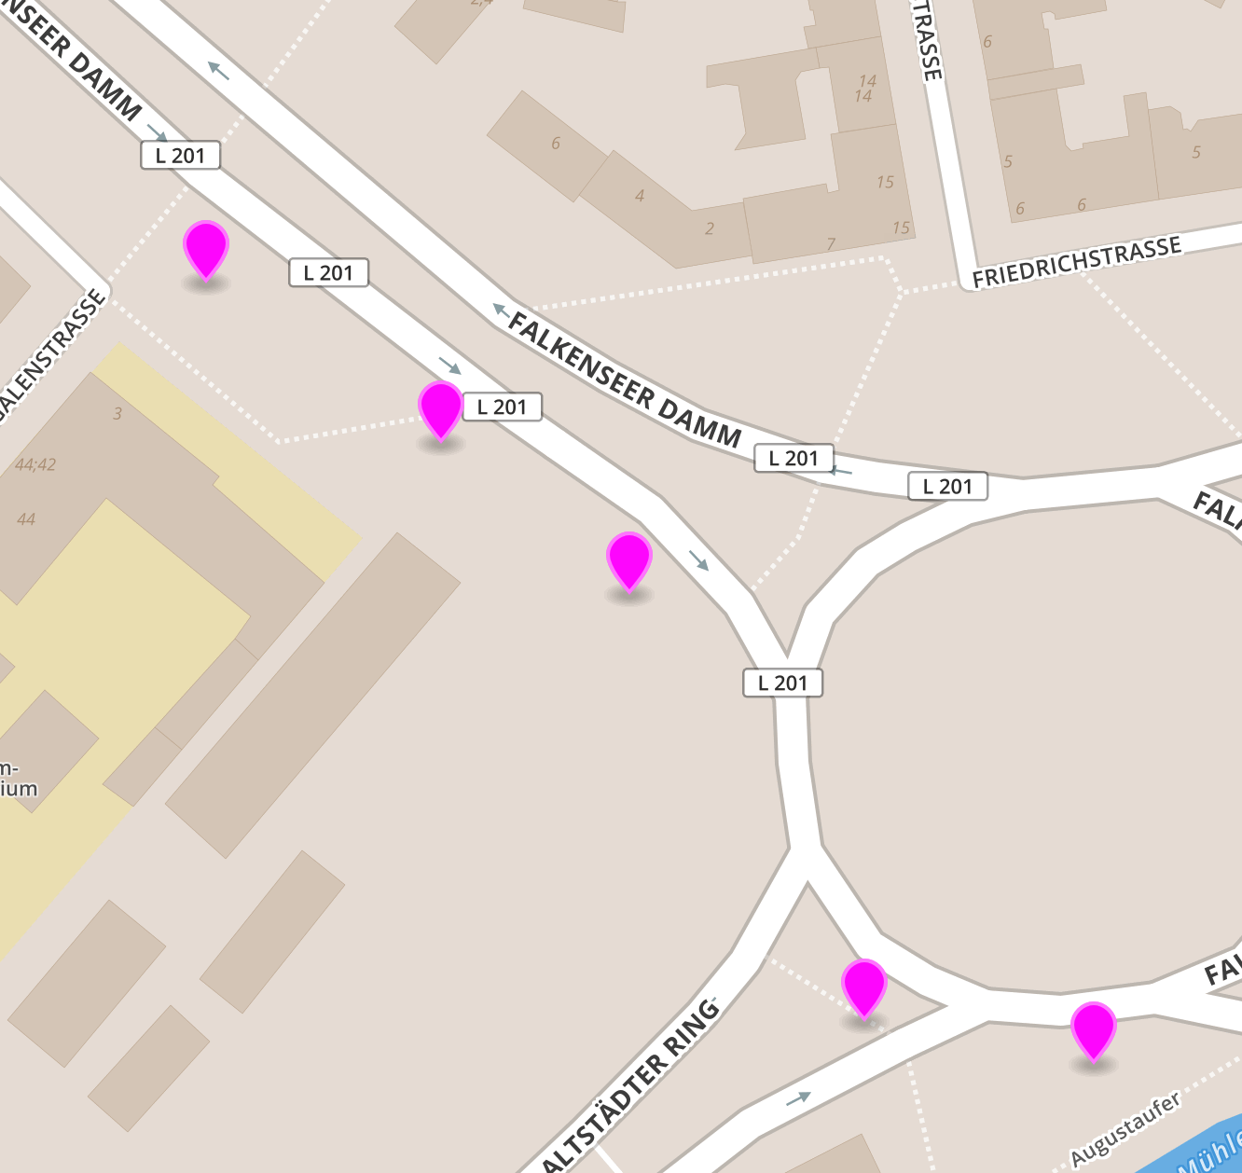
Valhalla’s meili
Init PriorityQueue
For each gps points
Find candidates within radius
For each candidate, relax, assign cost by
Emission cost
Transition cost
Program will stopped when candidates matched to last points pop out from PQ

Slide 27

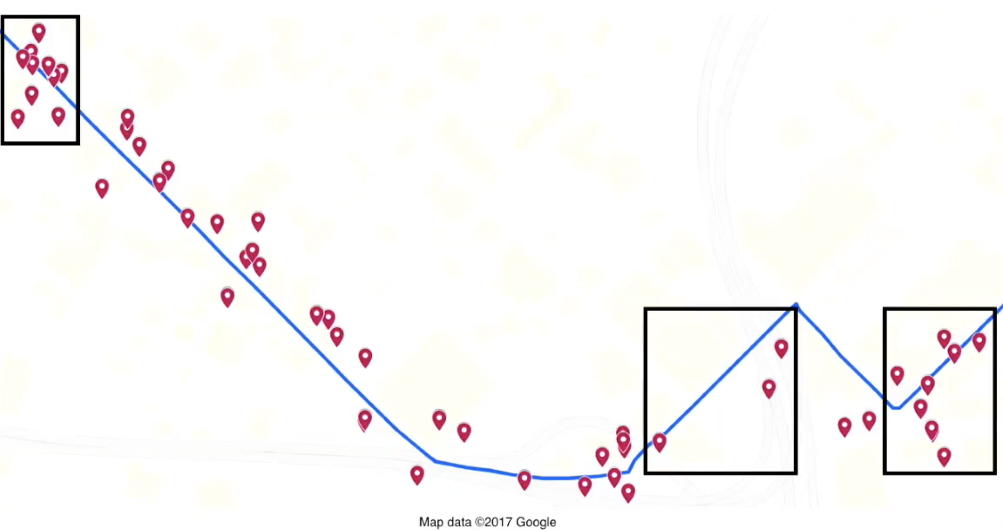
Filter dense gps

Slide 28
GPS noise
Real time
Active guidance
GPS direction
Gyro
Offline
- Post processing, certain road segments pair has unreasonable distance and if we remove them could get better result

Slide 29
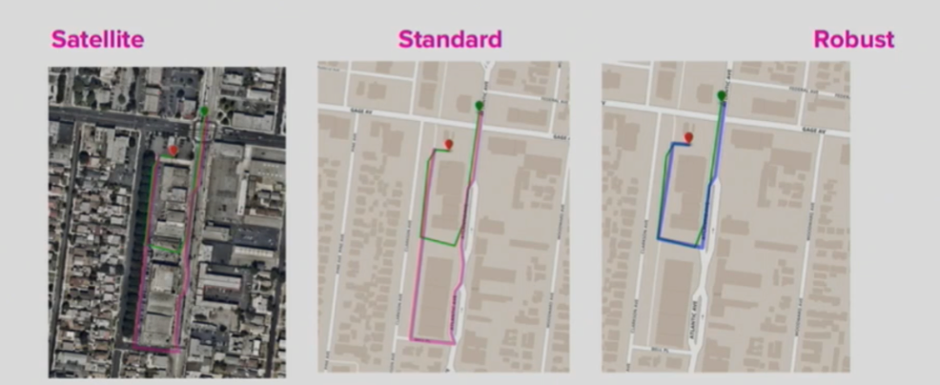
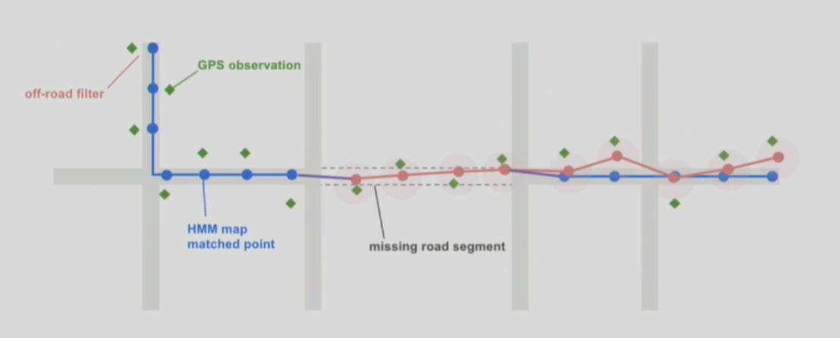

When map is wrong (LYFT’s way)

Slide 30


